Slide 1
Introduction to Topological data analysis (TDA)
Barney Ricca
SCTPLS 2020 Conference
A topologist is someone who eats his coffee cup and drinks from his donut.
- Old topology “joke”
Notes:
Online abstract: http://www.societyforchaostheory.org/conf/2020/cfp/revise.cgi?id=20200501164535
30 minutes
This workshop will introduce participants to the use of topological data analysis. Nonlinear data suffer from a number of properties that greatly limit the use of traditional data analysis techniques. Three problems in particular are both endemic to nonlinear data and not addressed by common techniques. First, the need to understand the "shape" of data (such as is accomplished with various embedding and state space techniques) can provide information about system dynamics even when these are a priori not known. Second, despite the fact that data may be sampled by an unknown process (e.g., neither normally nor uniformly sampled, and often not sampled by any analytic process), the researcher would like to make claims about the population from which the sample was drawn. Third, there are many situations where the difference between noise and signal cannot be determined in any theoretical manner, and so only arbitrary boundaries between those two can be used. The last two decades, however, have seen principles of topology applied to statistics, resulting in topological data analysis (TDA); TDA is ideally suited to address many problems of data shape, population and samples, and noise vs. signal.
In this workshop, three topological concepts will be introduced, explained, and used in the analysis of data: Betti numbers, level sets, and "coverings". Betti numbers describe a topological set by counting how many objects are in the set, and how many "holes" of different dimensions are in the set. Level sets are one way of characterizing the minima and maxima of sets, such as a graph or a time series of data. Coverings of a data set can roughly be understood as attaching a disk or ball of a given radius to each point of the data set. Of particular importance in TDA is the concept of persistent homology, which is the study of how these topological features (here, Betti numbers and level sets), when applied to the "covering" of a data set, persist over many different scales (i.e., radii) of that covering. The persistent homology approach allows the data set to define the important scales rather than having those scales imposed by the analyst. The application of persistent homology to data results in "bar codes" and/or "persistence diagrams"; each of these objects can be used to identify the shapes that underlie data or distinguish between noise and signal.
This workshop will introduce the participants to the elements of persistent homology and how to apply that to the shape of data, the analysis of single time series data, and how to work with data from multiple time series. Using both simulated and real data, this workshop will apply both the ideas of level sets and Betti numbers to better understand complex data. Although all participants will benefit from the presentation of persistent homology methods, this workshop will include examples of data analysis using the R statistical environment; hence, the fullest benefit will accrue to those who have some familiarity with the R statistical environment and have access to R during the workshop.

Slide 2
Online repository
You can get all this online:
This presentation deck
Access to data being used
R Script
Output from the script used in the figures here
Go to:
https://bit.ly/SCTPLS-TDA
I’ll put this link in a chat comment, now that we’ve started

Slide 3
Introductions
Me:
Barney Ricca
St. John Fisher College (Rochester, NY, USA)
bricca@sjfc.edu
Started in physics (musical acoustics); wandered through complex systems, STEM education, and (now) data science
Question for you:
In a chat (to everyone)…from what systems do you get data?

Slide 4
Objectives
At the end of this workshop, you should:
Possess basic conceptual knowledge of topology
Be able to identify situations where TDA may useful
Have a source for some basic TDA in R (via the script)
Better sources exist, but they require more in-depth knowledge than will happen here
This one is still in development
Be able to interpret TDA results

Slide 5
Outline
What one might want to do with data
Topology survival kit
Conceptual
Topology applied to data
Discussion
Notes:
Will work in all but some pathological cases

Slide 6
Data

Slide 7
Messy nonlinear data
Things we might want to know about data:
Shape of data
Embedded in an abstract space
Find population from sample (sampling process unknown)
Single data stream time series
Noise vs. signal
Better sensitivity RQA
Multiple data streams
Fitting them together (e.g., cross recurrence quantification analysis, dynamic time warping)

Slide 8
Topology: An Introduction

Slide 9
Topology
Really, topology is about transformations
Geometry: properties that are preserved under rotations, translations, and reflections
Topology: properties that are preserved under homology
Huh?!
Stretch, twist, deform, bend, move, etc., but not cut or glue or tie, etc.
We’ll do a simplified approach to topology & homology;
Avoid simplexes, filtrations, Ripf vs. Cech, etc.,
Instead, we’ll rely on examples and generalize from there
Notice, the workshop objectives did not include a full in-depth approach to topology
Will almost certainly be correct for real-world data that are encountered in psychology, economics, etc.
But be careful

Slide 10
Three important concepts
Betti numbers
Coverings
Level sets*
Identifying features & regions
Persistence: How to use the previous two with data
Persistence Diagrams
The workhorse
Bottleneck distances
Persistence landscapes
And RQA on persistence landscapes (Zhang, et al., 2020)
Notes:
Sadly, “level sets” is also used with time series, but in another context. Sigh.

Slide 11
Betti numbers
Give the number of different types of features that an object possesses
Features: Objects and holes
Objects (0-d holes) – β₀
Circles (1-d holes) – β₁
Balloons (2-d holes) – β₂
and more, in higher dimensions
Embedding
An example may help

Slide 12
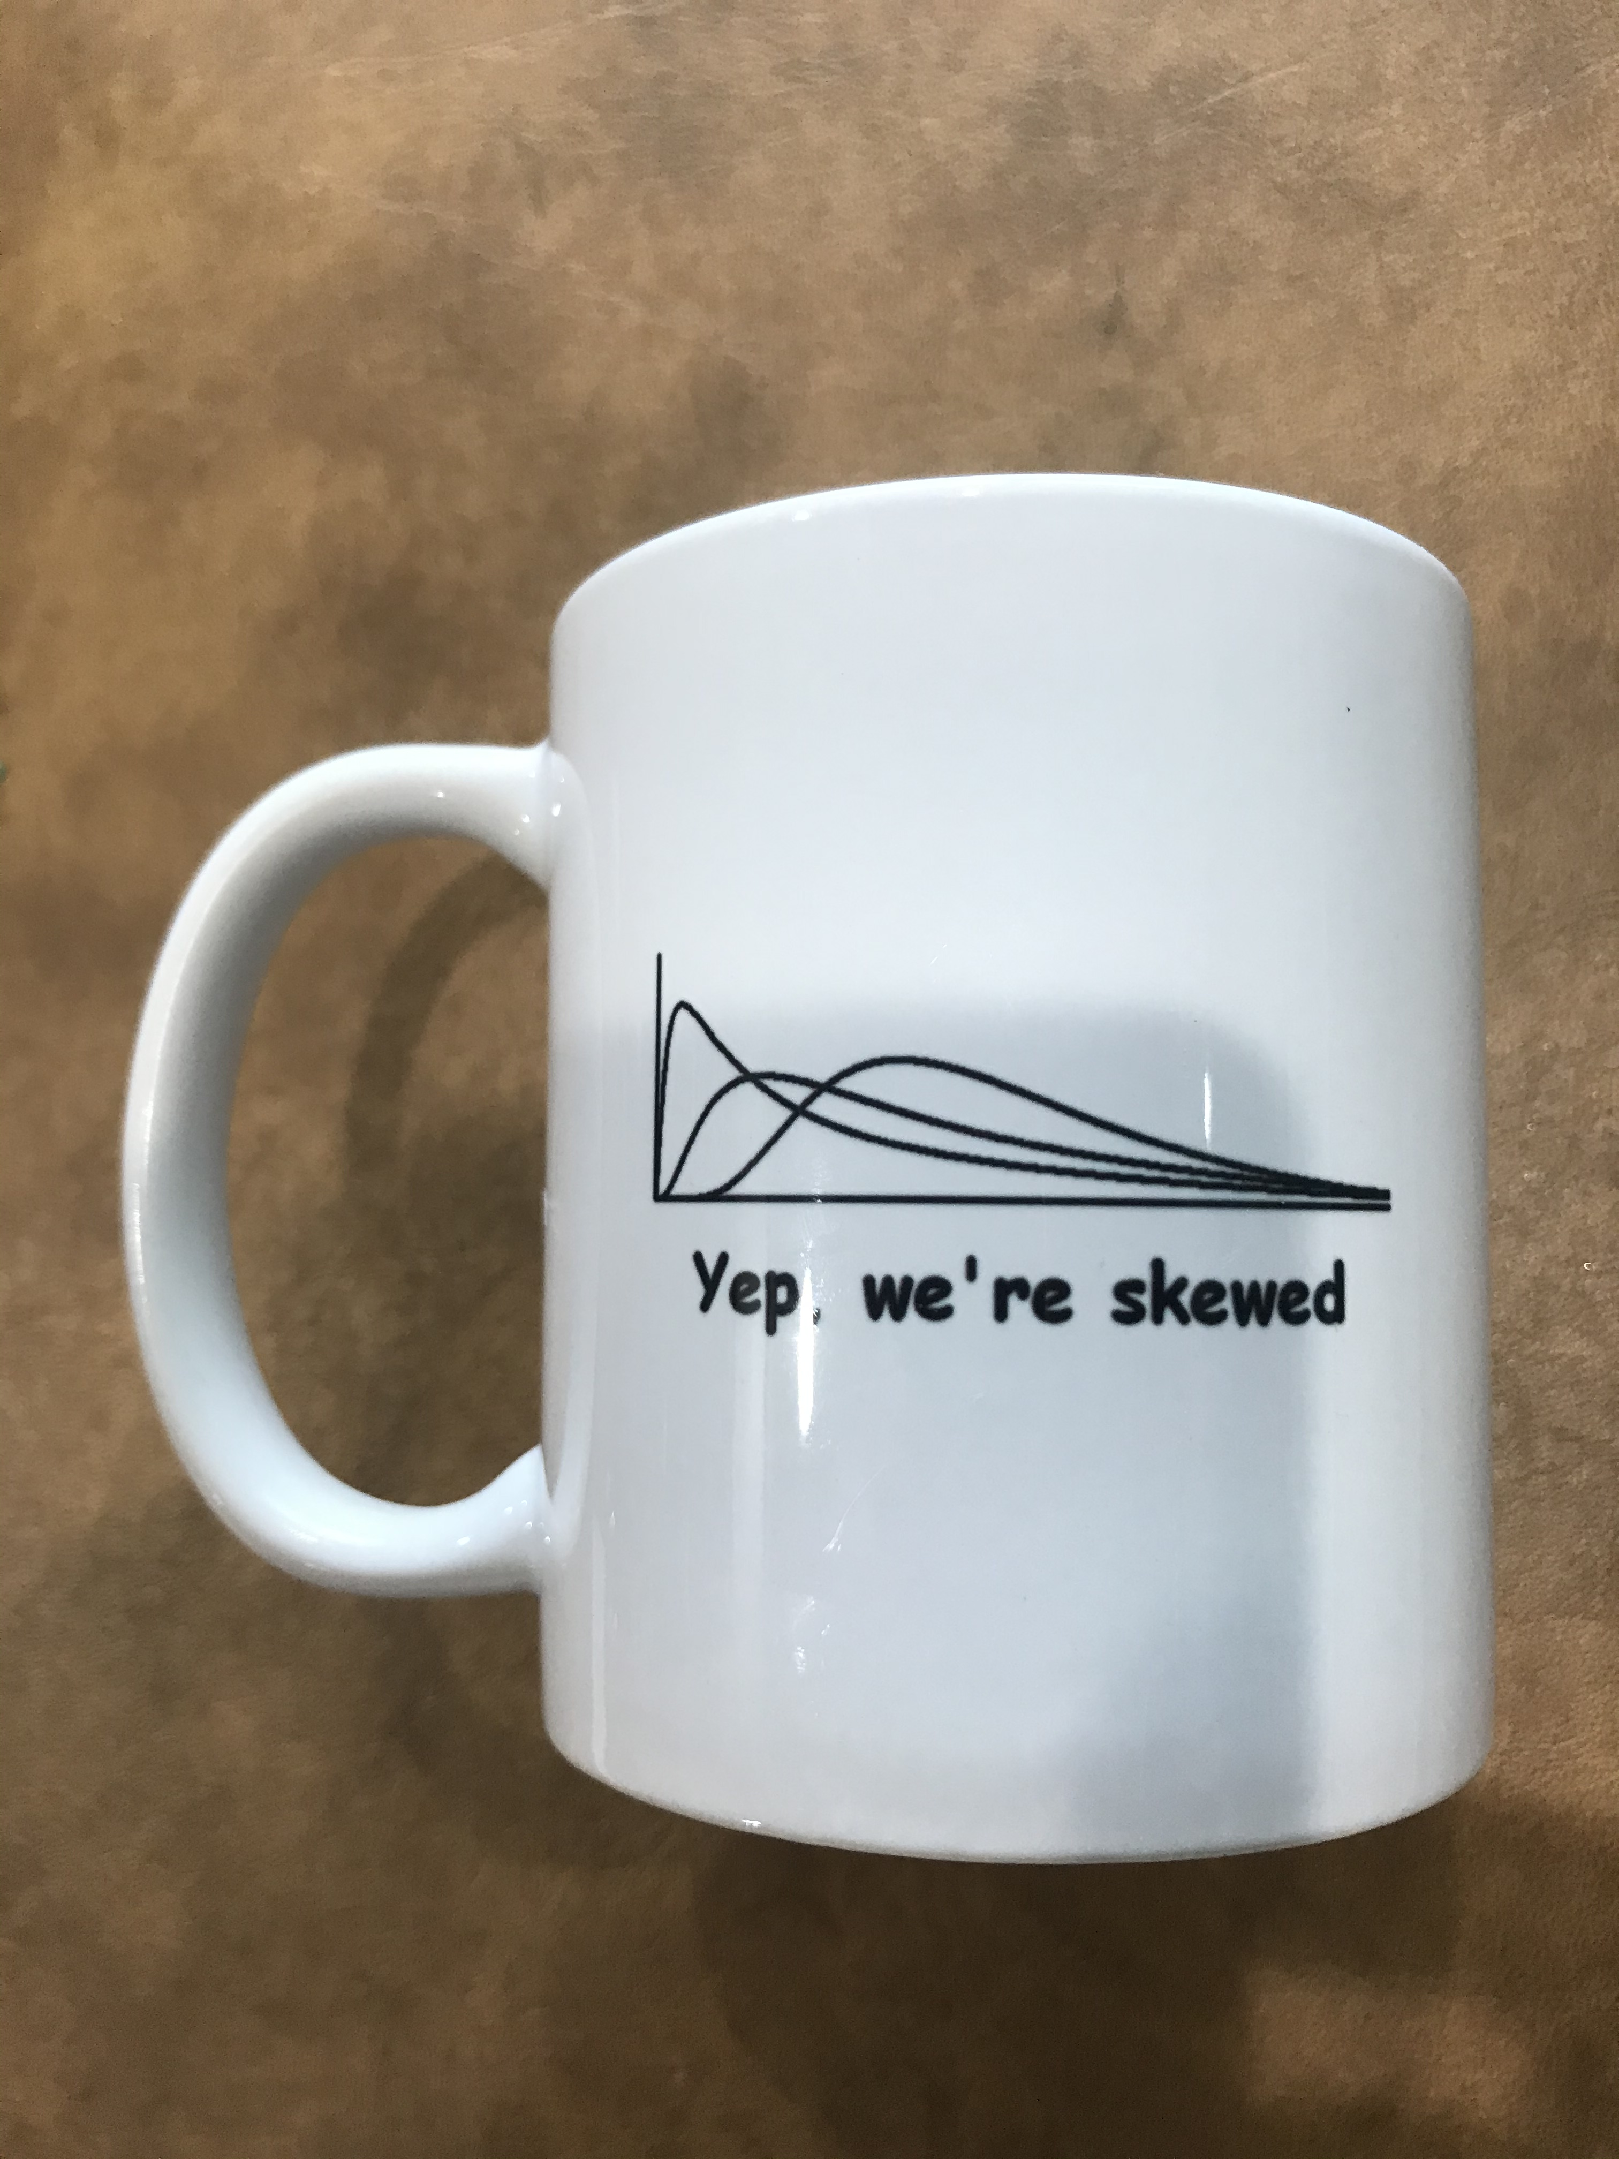
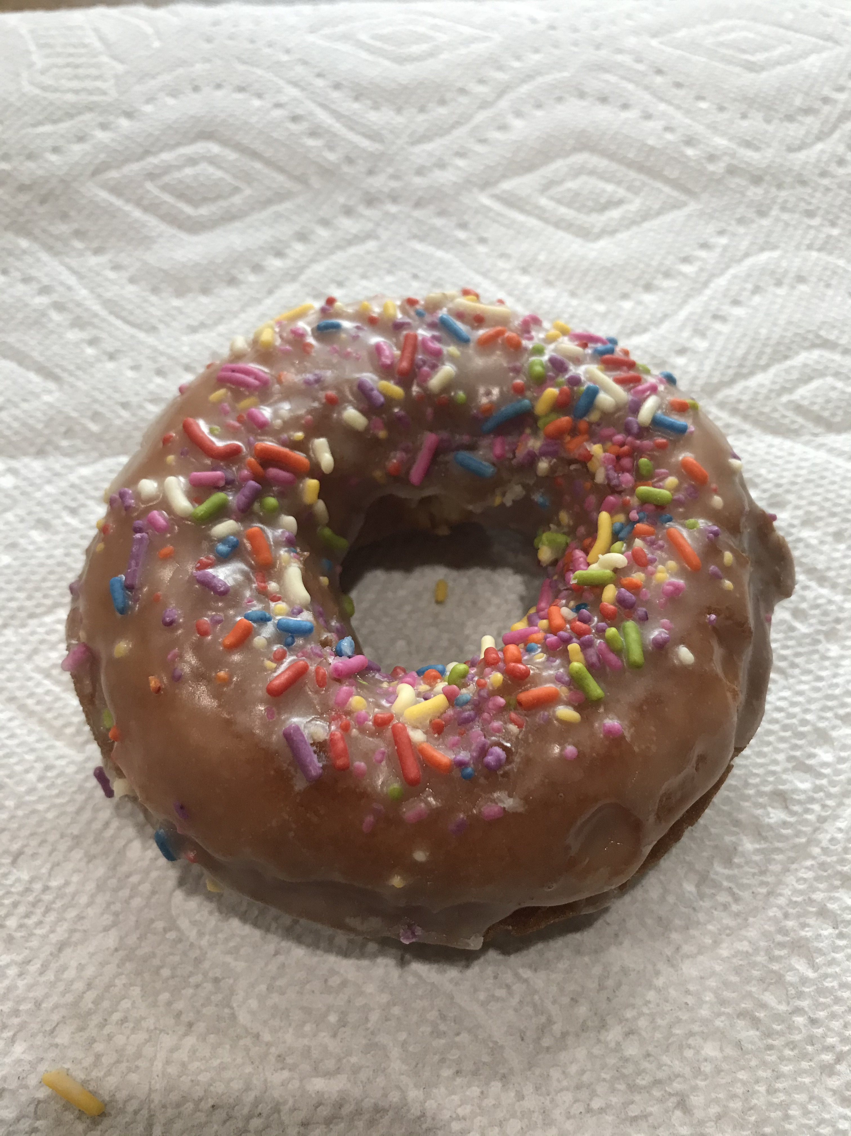
A donut and a coffee cup
Each of these is:
1 object

Slide 13
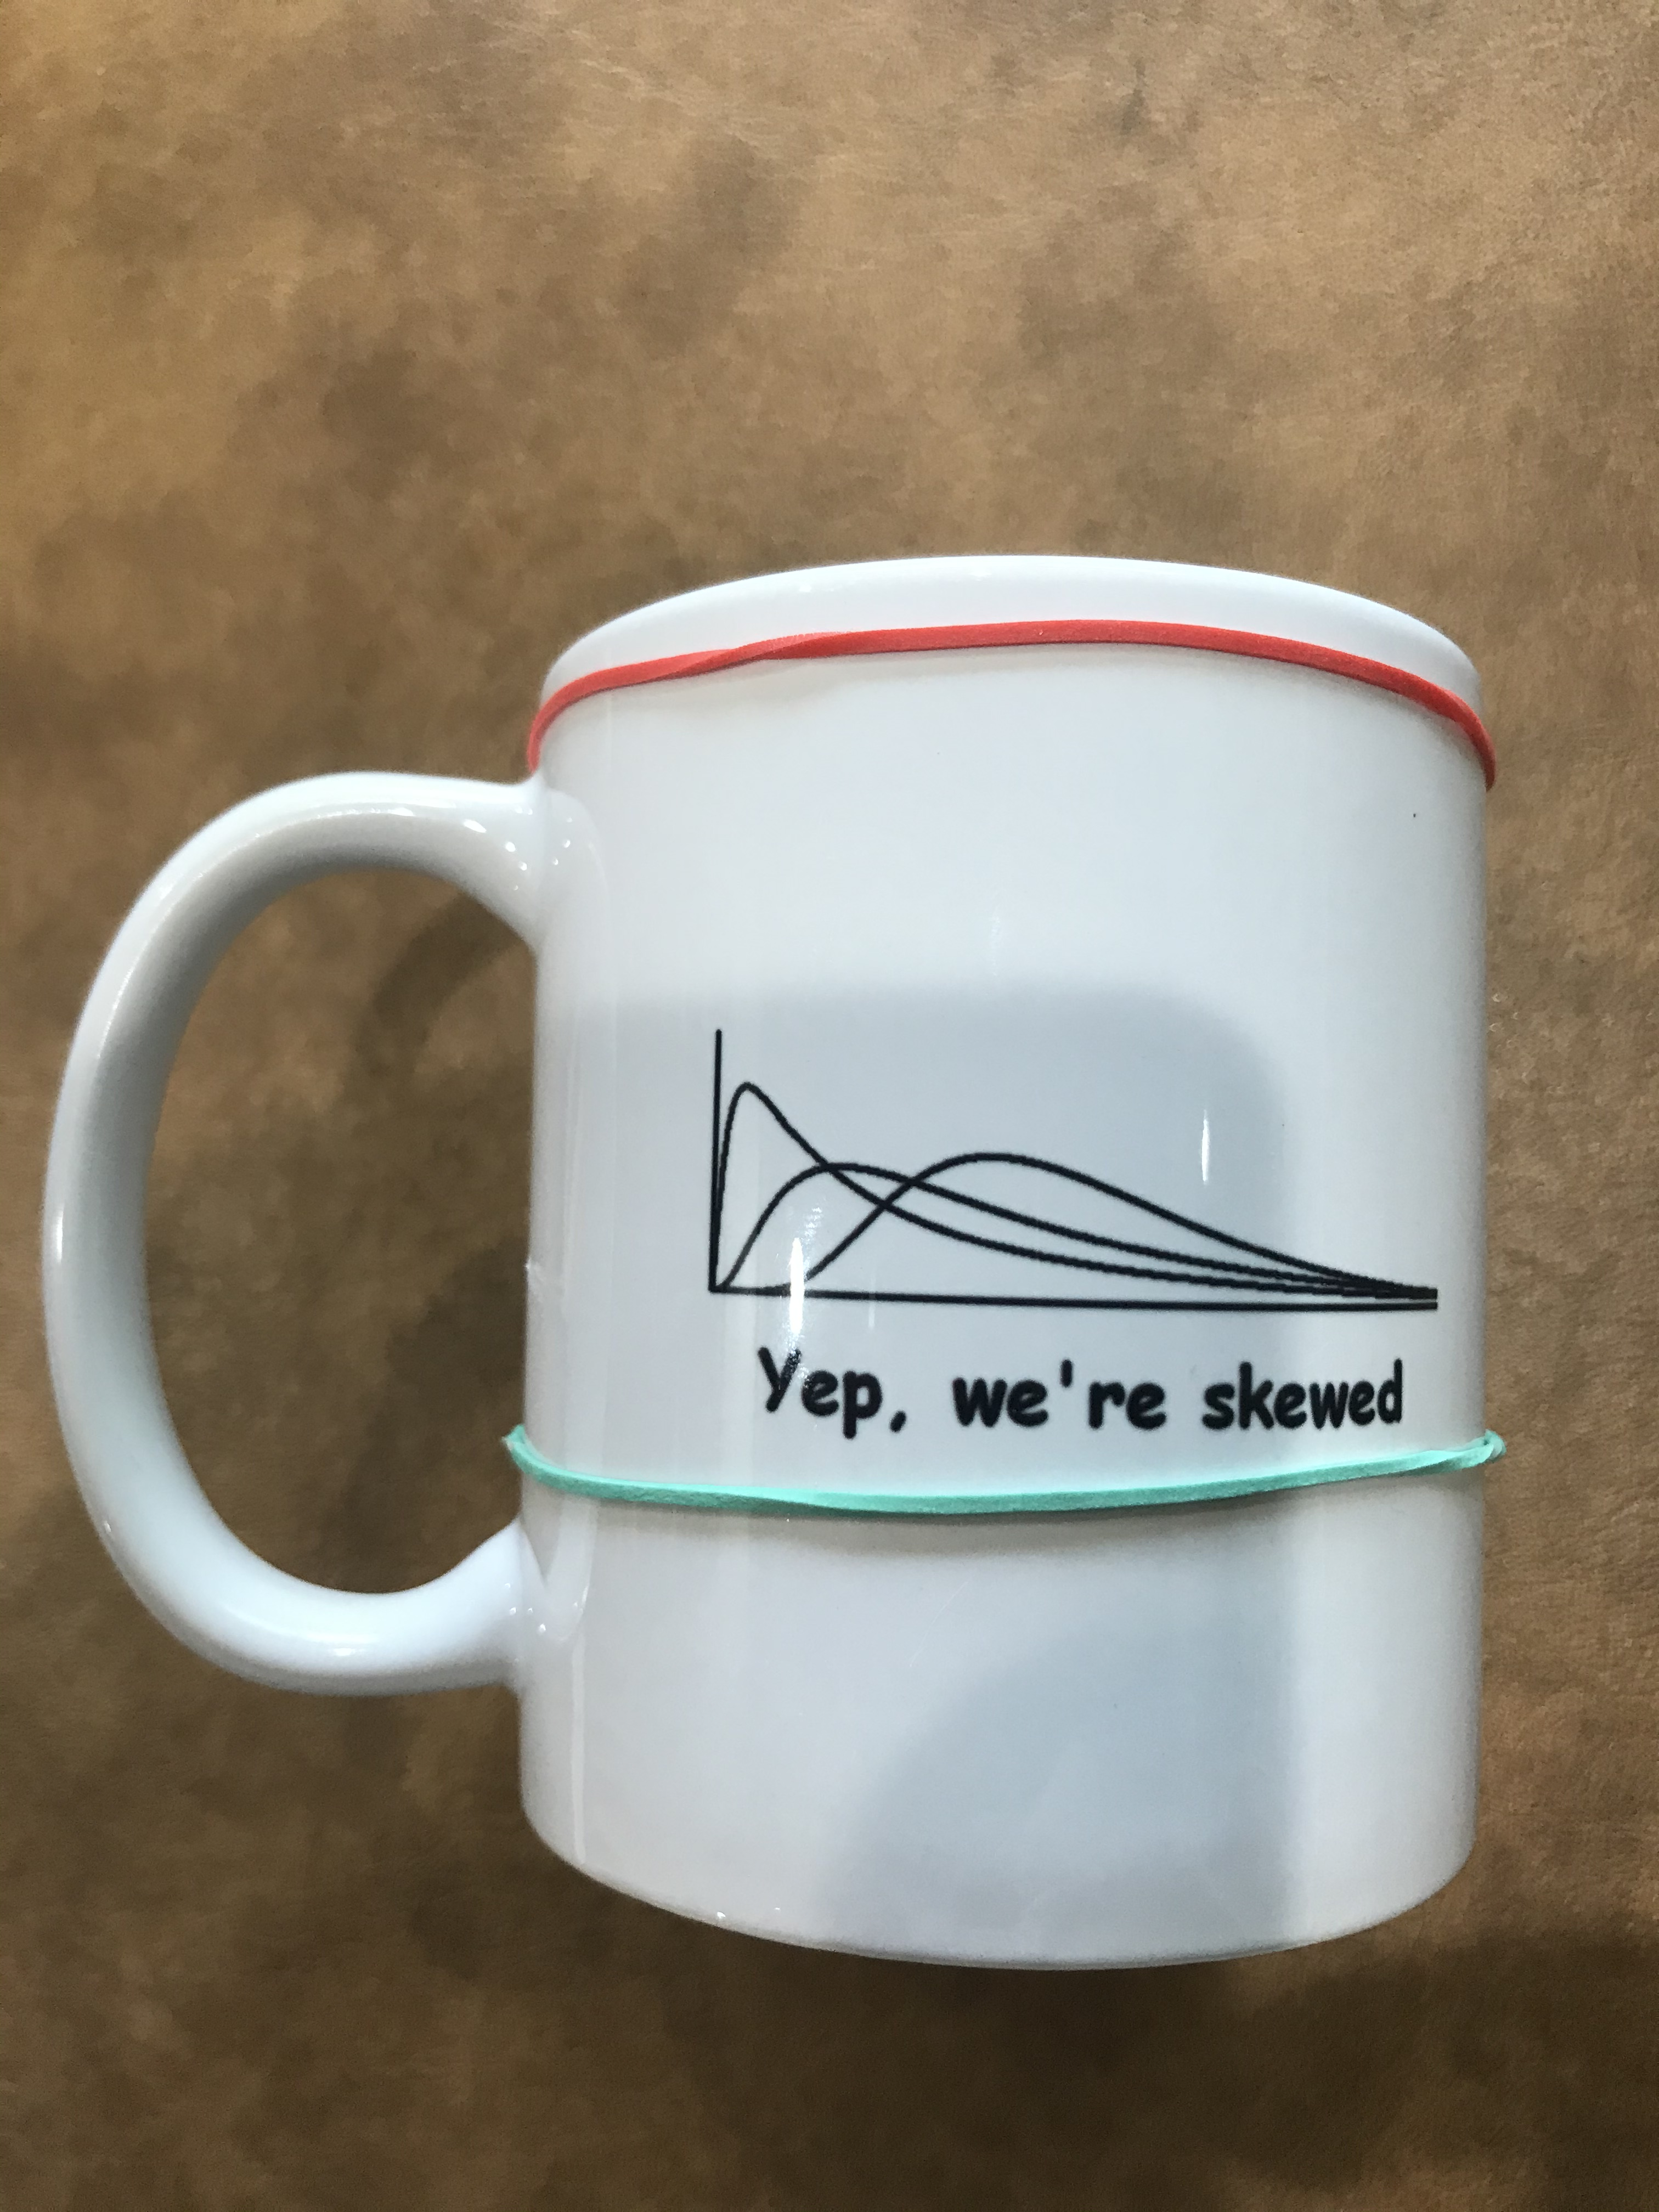
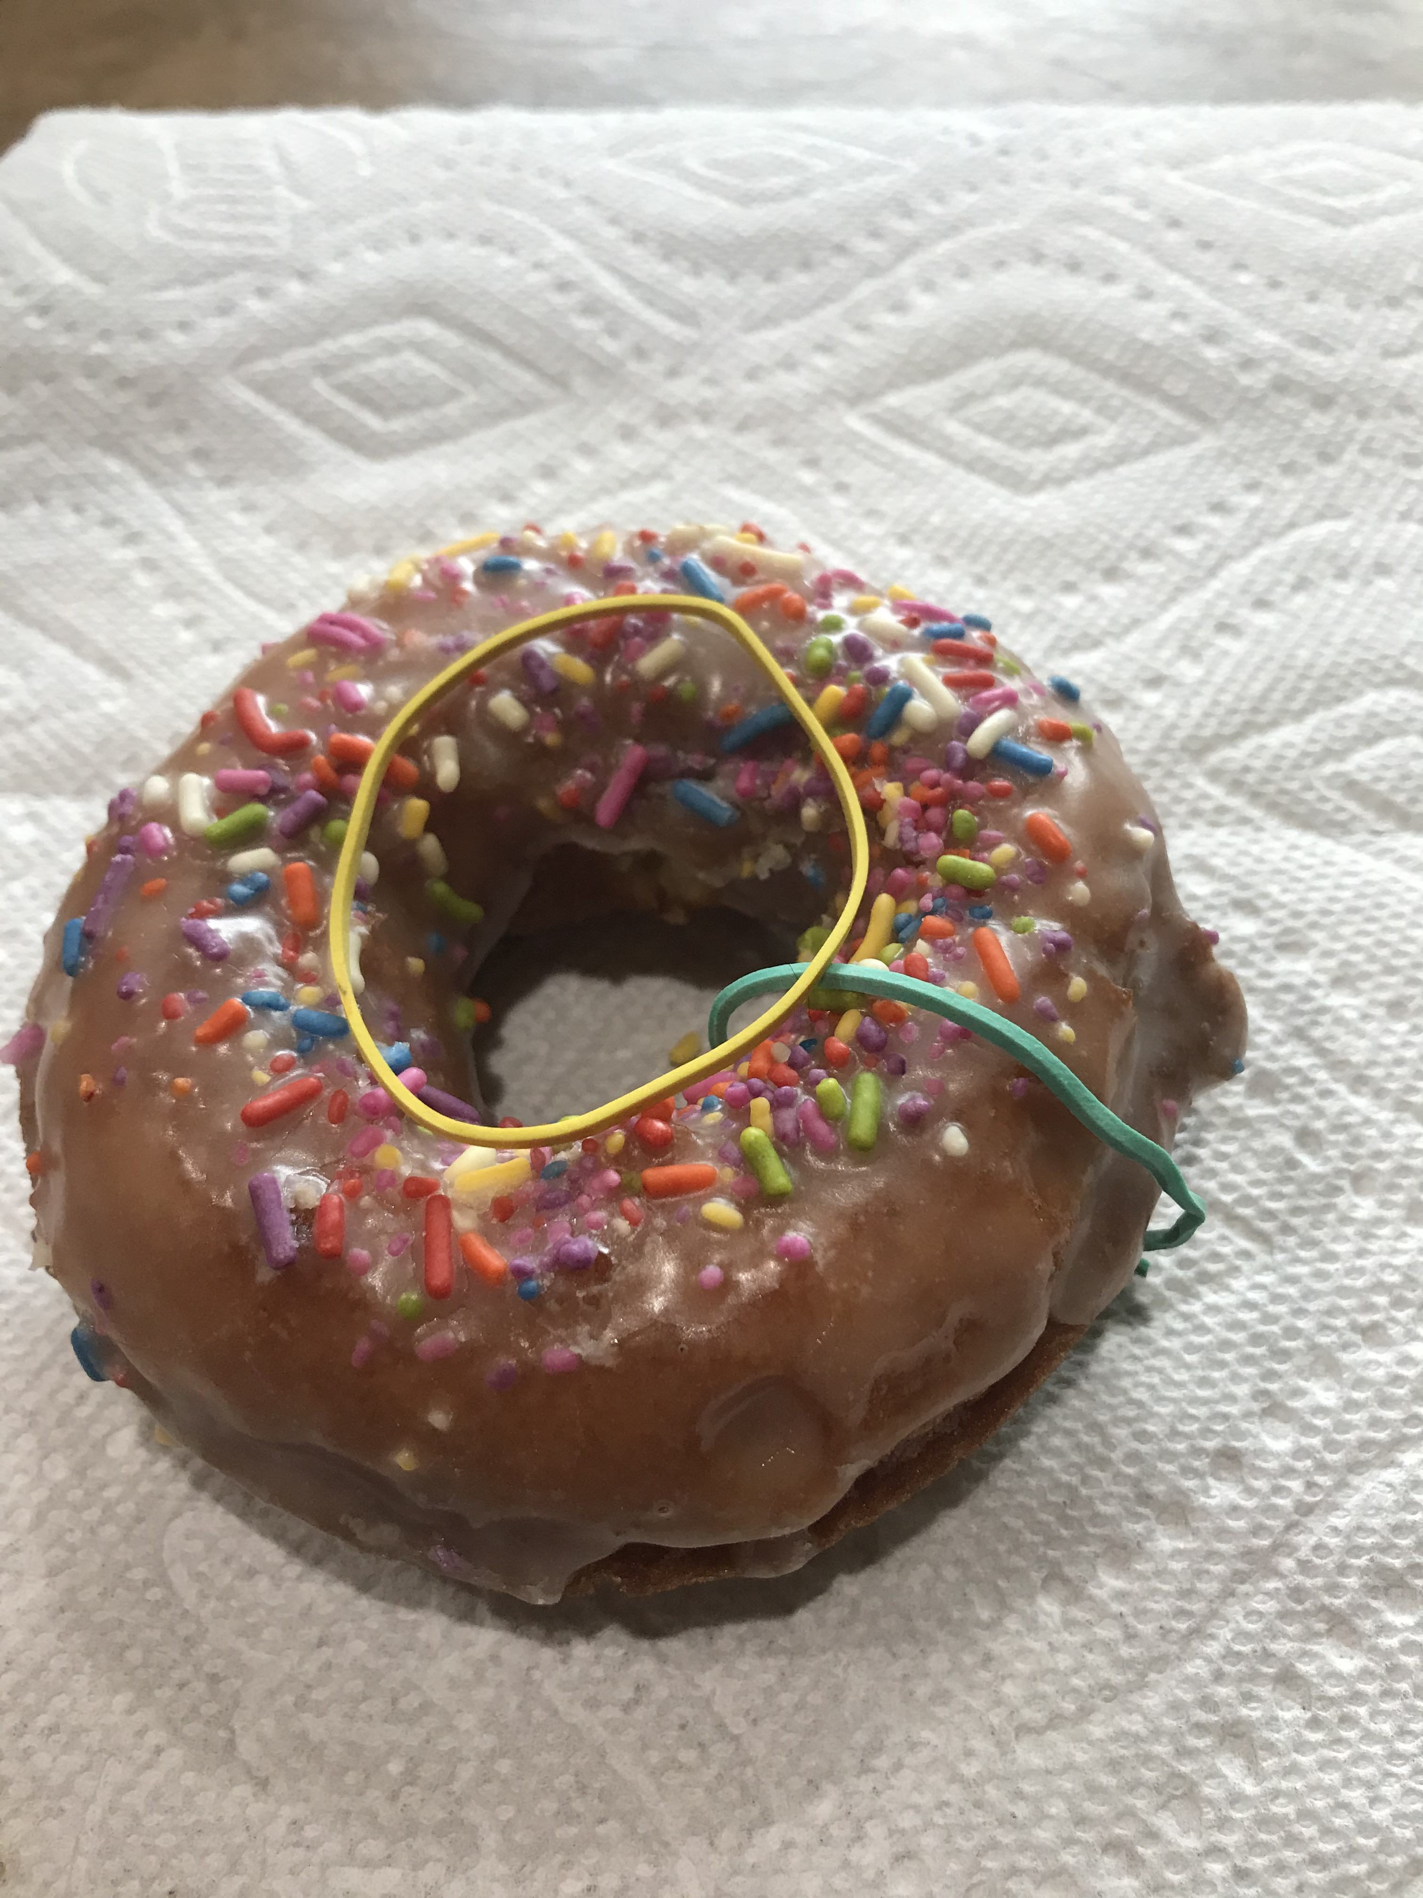
A donut and a coffee cup
Each of these is:
1 object
2 different circles
Notes:
Try moving one rubber band to the other without cutting either the rubber band or the donut/cup

Slide 14
A donut and a coffee cup
Each of these is:
1 object
2 different circles
1 balloon will surround them
Notes:
Try moving one rubber band to the other without cutting either the rubber band or the donut/cup

Slide 15
A donut and a coffee cup
Each of these is:
1 object
2 different circles
1 balloon
Therefore, they are the same (topologically)!
Notes:
So, the confusion is (to a topologist) understandable.

Slide 16
Betti Example
16 “A”s in 1 “B” shape
Initially, β₀ = 16, and β₁ = 16
Then, we look at the coverings
Cover each data point (e.g., each pixel) with a ball of a small radius
Start with radius = 0
Radii change, and as they do, so do the number of objects and holes!
Let’s look at how each of the various “features” comes into existence (i.e., is born) or goes away (i.e., dies) as the radius of the balls increases

Slide 17
Persistent homology
Which features are important?
TDA can help us think about this
Identifies features that are persistent across a range of scales
Scales of what?
Scales of the objects themselves
I.e., As the objects are blurred (or as you zoom out) what features are the same across a large range of blurring/zooming?

Slide 18
Persistence diagrams
Plot the births and deaths of features on a two-dimensional graph
Horizontal axis: Birth scale
Vertical axis: Death scale
45º line for reference (can’t be born after you die!)
Helpfulness:
Further from the diagonal = better representative of system
Bootstrapped significance of features
Separate noise from signal!
Bottleneck distance
Measure of similarity for comparing two or more systems

Slide 19
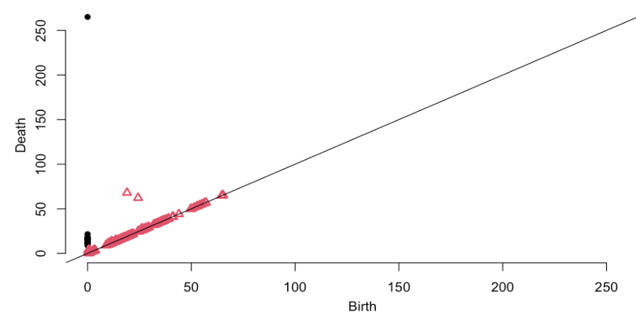
Persistence Diagram: A-B covering
Notes:
Notice the features not near the diagonal line:
The 2 holes in the B, and 1 object.
Most of the holes are born and die because they are bounded by 3 circles temporarily
16 of the holes are born at 0 and die at about 3.5 (the original holes)
Several thousand objects are born at 0 and die immediately; each ”pixel” is its own object.
16 of the objects are born at 0, and die later; 15 die from 10-20 pixels later, and one continues forever

Slide 20
A-B Features & Persistence
Objects
Holes

Slide 21
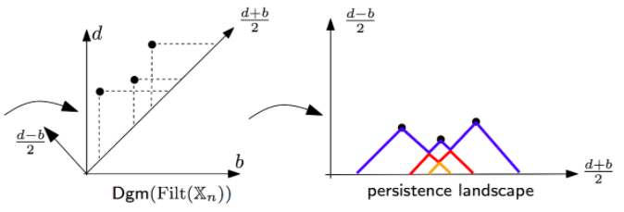
Persistence landscapes
Sort of a 45º clockwise rotation of the persistence diagram
Vertical lines up from the line birth = death to the features
Horizontal lines right from the feature to the line birth = death
Rotate
Notes:
http://bertrand.michel.perso.math.cnrs.fr/Enseignements/TDA/Tuto-Part4.html

Slide 22
Level sets
Draining a lake
Features: How many ponds? How many islands?
Really, topologists use levels that increase, not decrease, but the principle is the same
Rules
Joining and splitting
Newest feature dies first, as the water level falls

Slide 23
Landscape (or time series!)

Slide 24
Flooded: 0 features

Slide 25
One feature

Slide 26
Two features

Slide 27
Three features

Slide 28
Two features (2nd one died)

Slide 29
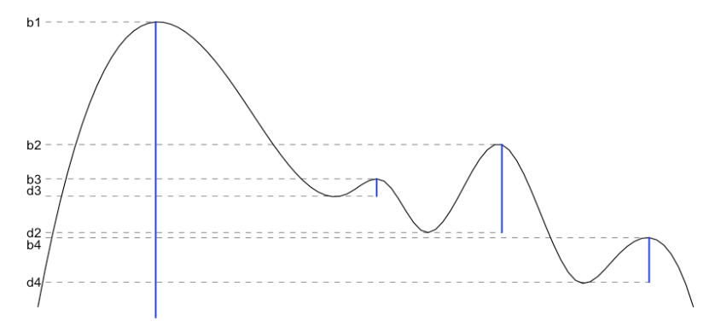
Final result: Births & deaths
Create a persistence diagram just as with coverings

Slide 30
Examples

Slide 31
Time Series: Learning to Walk
Early exploratory work I’m doing with Marybeth Grant-Buetler & Richard Buetler
It’s Marybeth’s data; I’m just the one with this crazy idea.
Dynamic Time Warping (DTW) is an almost topological approach
Smooth data using significant topological features, then use DTW
Compare infants’ leg motions at different stages of development
Very noisy
TDA can help!
Let’s look at some plots

Slide 33
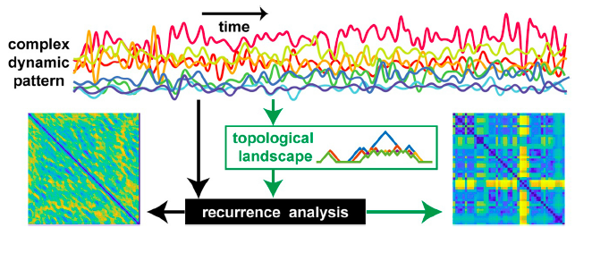
Multiple time series
Zhang et al. (2020). Topological portraits of multiscale coordination dynamics

Slide 34
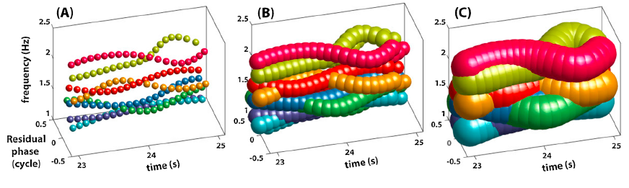
TDA -> RQA
Betti numbers -> Persistence landscape -> RQA

Slide 35
In practice: To the R Cave!

Slide 36
Questions and Discussion
Contact me: bricca@sjfc.edu
This presentation: https://bit.ly/SCTPLS-TDA

